Slide 1
Uni Social

Slide 2
“UniSocial” is a social app for university students.
The app includes features such as an event page and chat room to keep students updated on the events going on in their university.
The chat rooms are filled with up to 15 students that are all attending the same event. It is a useful way for students, especially freshers, to meet and make new friends. The chat rooms are temporary, so shortly after the event has occurred the chat room will be deleted.

Slide 3
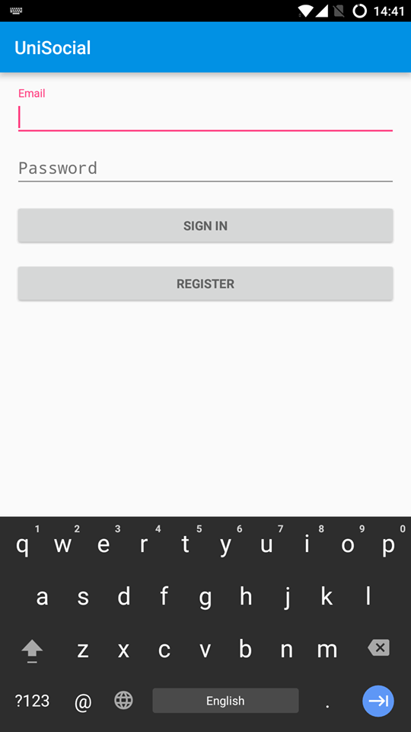
Login page
Title of current page
User’s should input e-mail
User input password
Sign in button
Register Button

Slide 4
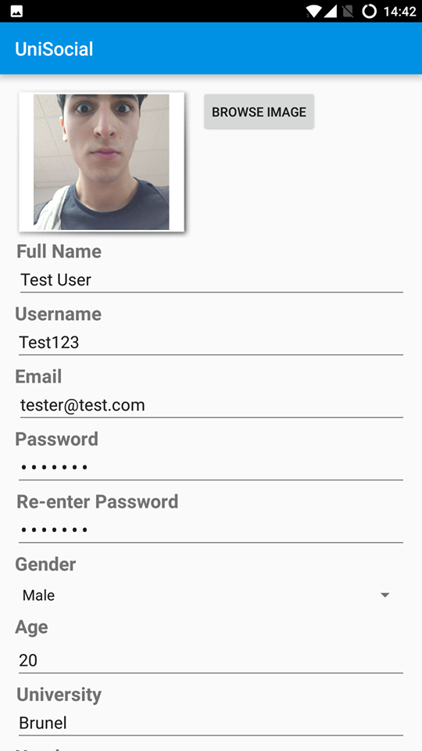
Sign up page
This is the user sign up page where individuals can become a member of the app. They have to register using their university email to validate that they actually attend a university.
Application name
This star represents the image of the UniSocial banner that will later be added.
Title of current page
Grey text displays what the user should type into each box, but once the text box is clicked on then the text disappears and the user can then type.
Title of what should go in each text box
Button to complete user registration

Slide 5
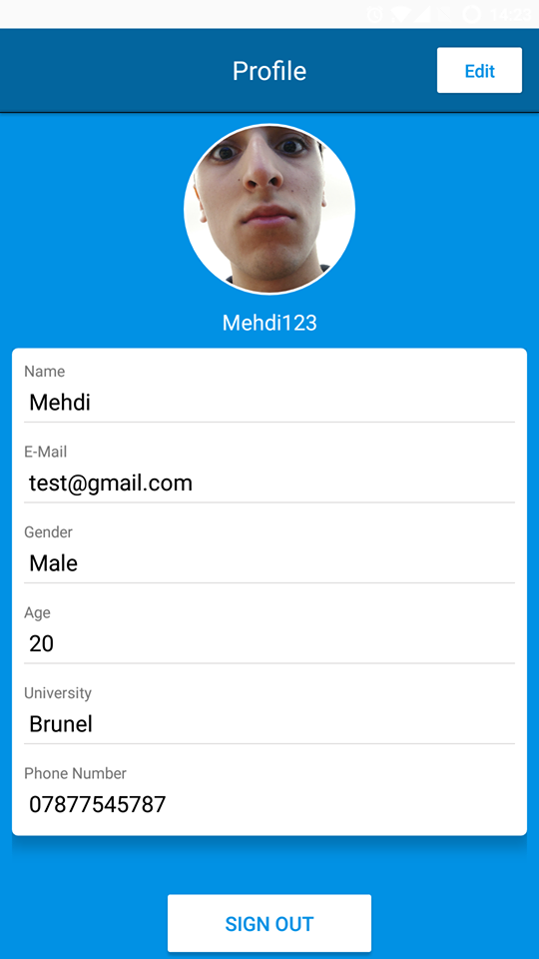
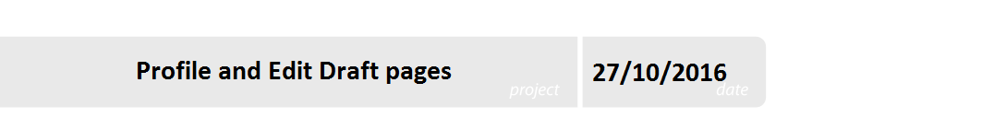
User profile/Edit profile
This page is displaying details that the user has created once first registering. It includes all their details as well as potential for the user to Edit if they’d like to change their details.

Slide 6
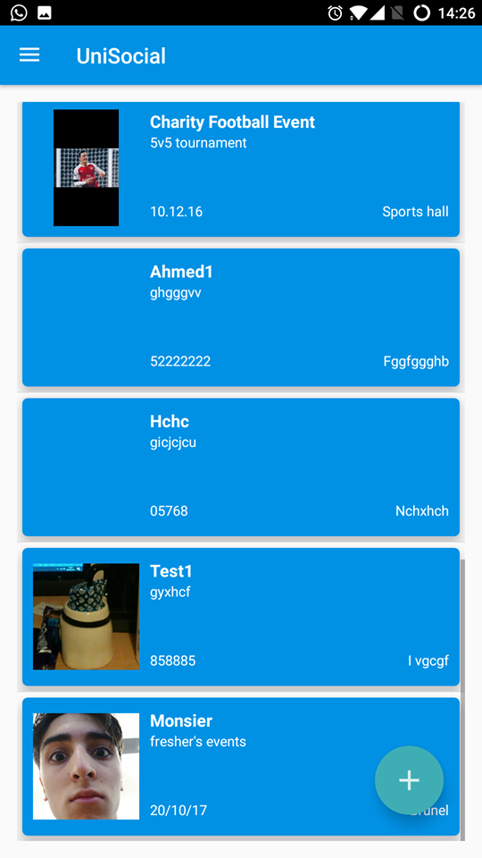
Event list
Back button
Event host’s name
Title of page
Event title
Image logos from each event’s host
The event list page contains the list of events that each uni is hosting.

Slide 7
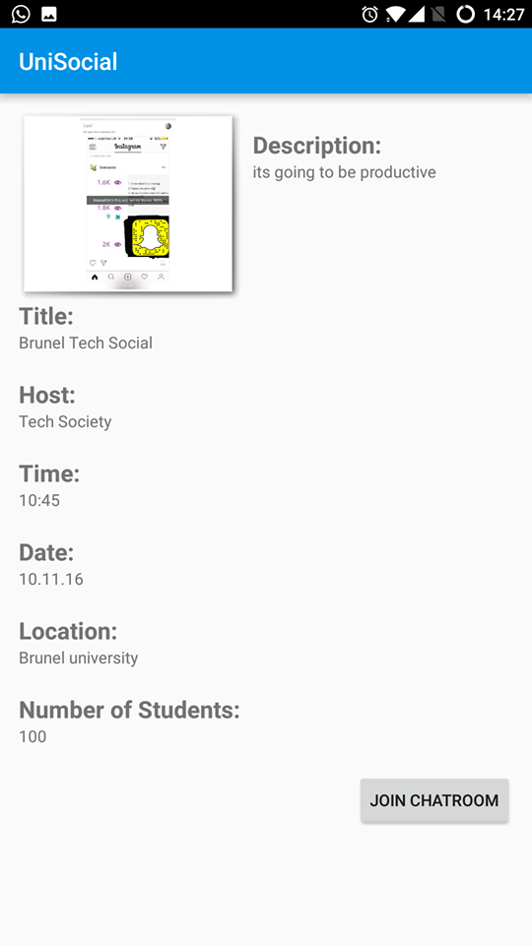
Event information page
On this page users can find out more details on the event they want to know about. An opaque image is used as the background image depending on who the host is. In the example, the Brunel Burners logo is used because they are the host of that current event.
Current page title
Opaque picture for the event in the background (this current picture isn’t opaque as didn’t have enough time to sort it.
The event title is in a slightly larger font as it is the most significant, then followed by the host name and other details such as date and time.
Event information; Event title, host name, event date, time and additional information about the event.

Slide 8
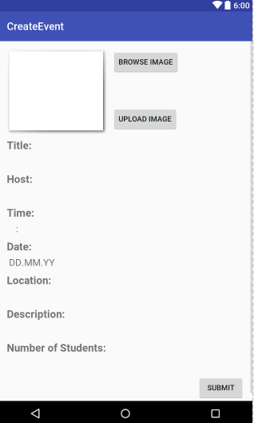
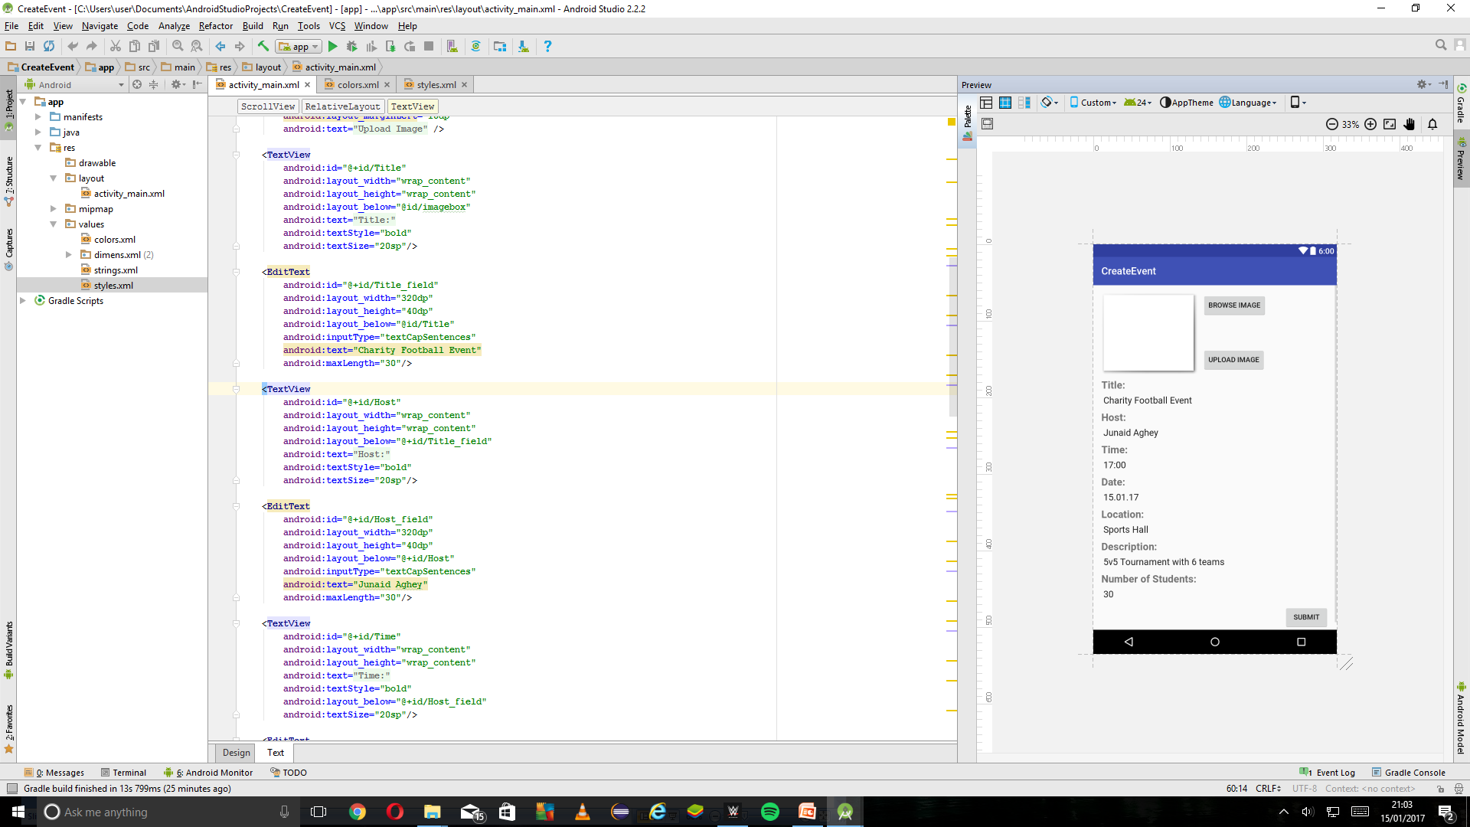

Create Event page/Manage event page
Event holder can browse an image from their gallery and upload it
Title, Host, Location and Description allows 30 characters
Time allows 6 characters
Date allows 8 characters
No of students allows 3 characters
Once submit button is pressed information is saved
Time, Date and Number of Students only allows numbers to be entered.
Time is entered in the format HH:MM, Date is entered in the format DD.MM.YY

Slide 9
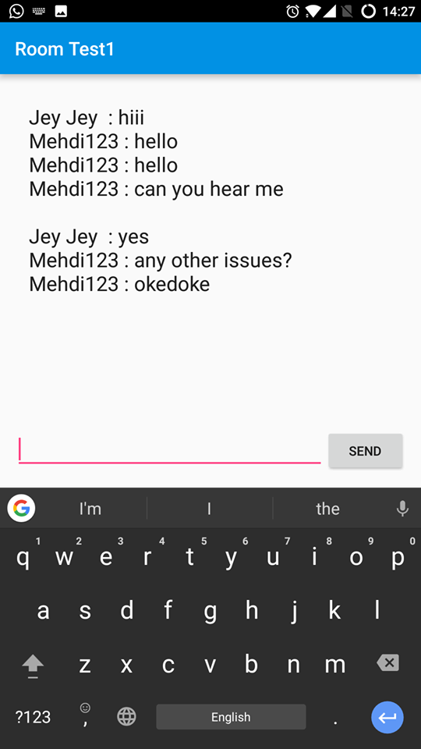
Chat room
Back button
Message(s) sent
Current group chat name
Section to type text
Message(s) received. Different colours to represent individual members of the chat
Send button

Slide 10
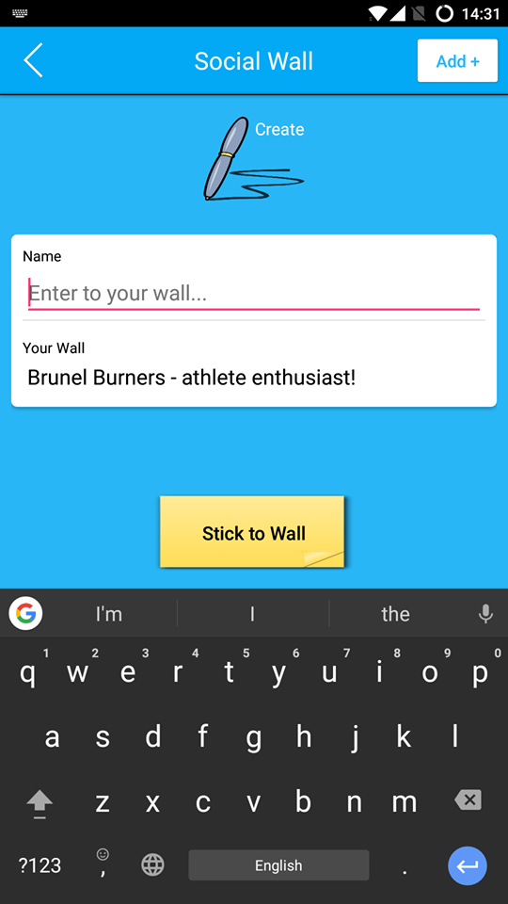
Social Wall
Users can make a new wall if they’d prefer to reset their page
Back button
Post update to wall, other users can will be able to view it through profile page
Input text into fields allows the page to update with necessary change
Text outputs onto the ‘Your Wall’ Section
Section to type text

Slide 11
Demo
Live demo of functional app

